Slide 1
Energy Fingerprint of HPC Workloads
A case study with HydraGNN training on DOE Supercomputers
Presented by,
Adithya Raman, University at Buffalo
Advised by,
Massimiliano Lupo Pasini, Jong Youl Choi, Kshitij Mehta

Slide 2
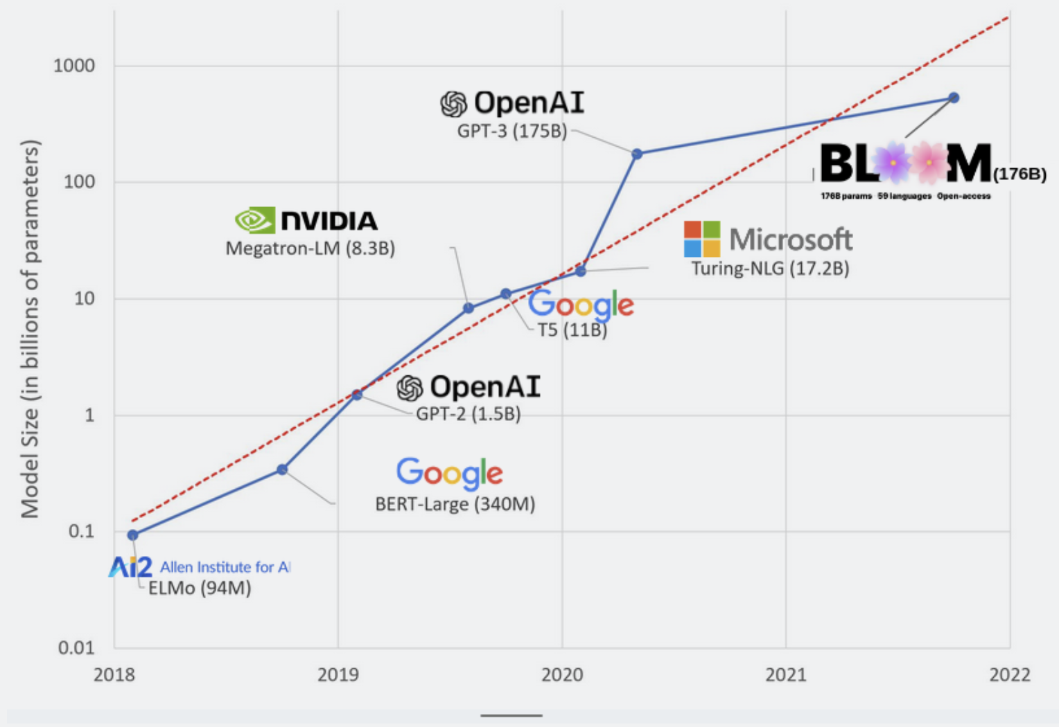
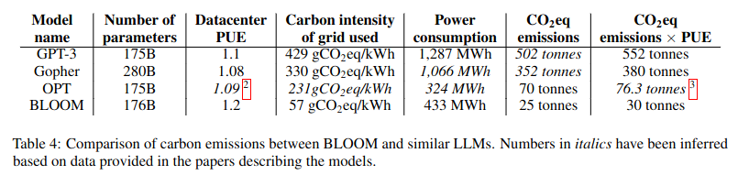
Overview of Energy Consumption in HPC & AI
⬆️ computational capabilities of modern hardware resources
TDP of AMD Instinct Series: 300W (MI100) → 560W (MI250) → 750W (MI300)*
Artificial Intelligence has benefited the most with this increasing computational power
Ability to train larger and more complex models with increasing amount of data
Growing energy bill for model training and increasing CO₂ emissions
Need for research and development in energy-efficient AI
Demand of lightweight and accurate profiling of the energy footprint of model training !!
Source: de Vries, Alex. (2023). The growing energy footprint of artificial intelligence. Joule. 7. 10.1016/j.joule.2023.09.004.

Slide 3
Building an Energy Profiler
Why profile energy?
.
Operational Efficiency:
Profiles help identify optimization opportunities, potentially lowering costs.
Sustainability Goals:
Reduced energy use aligns with broader sustainability initiatives in computing
Impact on Reproducibility:
Establishing energy baselines by providing an additional metric to verify consistency in results
Desirable Features:
Hardware Agnostic
Hardware type: CPU, GPU, Memory
Vendors: Nvidia, AMD, Intel
Minimal code instrumentation
Minimal overhead in execution time and power
Ability to monitor parallel and concurrent access to the same resource

Slide 4

Energy Fingerprinting
What is an Energy Fingerprint?
Unique profile of an HPC job, capturing the energy consumption patterns of its underlying functions and methods.
Uniqueness and Reproducibility: Each job has a distinct energy fingerprint, which, when profiled consistently, should remain reproducible across runs under similar conditions.
Applications
Benchmarking and Validation: Provides a standard for comparing similar jobs, helping detect deviations or inefficiencies.
Workflow Optimization: Identifies the most energy-intensive parts of a job, guiding optimizations to reduce power draw and improve efficiency.
Reproducibility Check: Serves as a baseline energy metric to verify that jobs reproduce accurately, contributing to workflow reliability and reproducibility efforts.

Slide 5
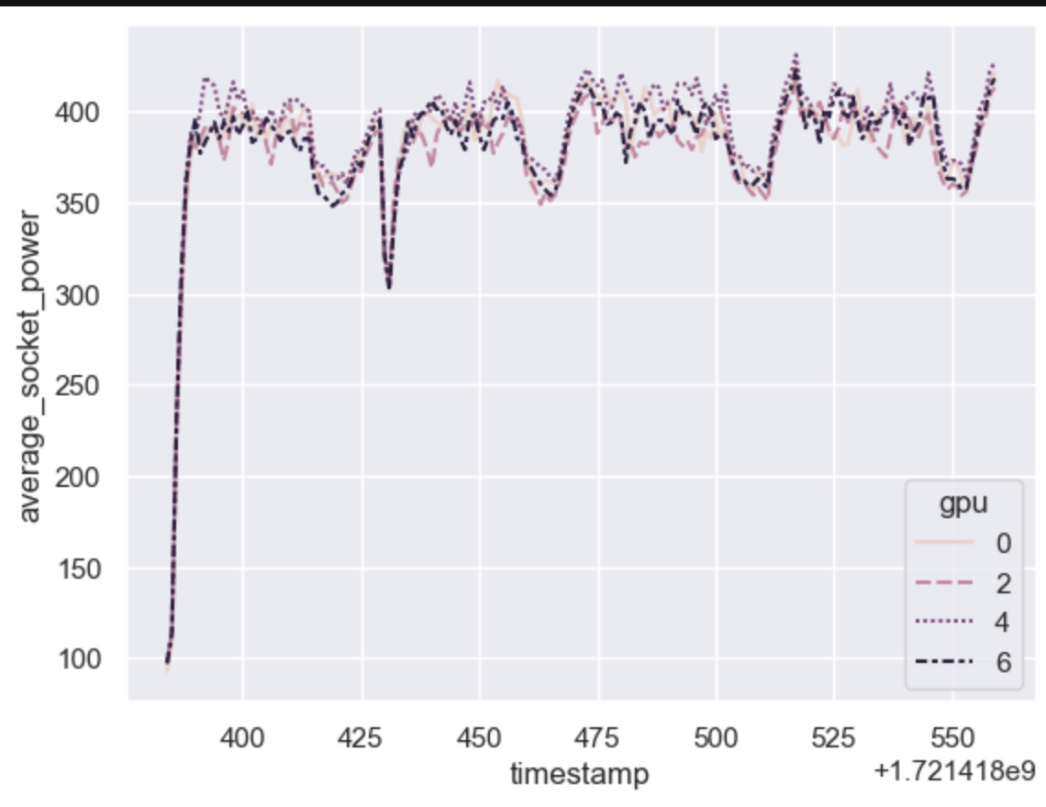
Level 1 Fingerprinting
Definition: Level-1 Fingerprinting captures power measurements over time, creating a Power Timeline of an HPC job.
Purpose:
This timeline shows how power (in Watts) fluctuates throughout the job’s execution, providing a high-level view of power draw patterns.
Highlights high-power phases in the job, indicating intensive computational or memory-bound operations.
Pros:
Detection of inefficient or idle phases
Low overhead
Minimal code re-configuration
Can be performed with existing libraries (amd-smi & nvidia-smi)
Cons:
Lack of code-level precision
Limited diagnostic value
Reduced insight for complex workflows

Slide 6
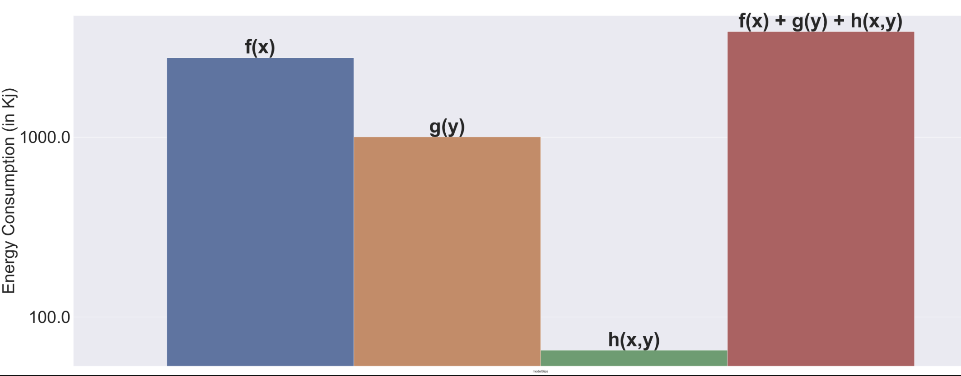
Level 2 Fingerprinting
Definition: Level-2 Fingerprinting captures the total energy consumption (in Joules) and execution time (sec) for individual function calls within an HPC job
Can track iterative calls to the same functions accumulating total energy and time
Average power usage per function can be computed by dividing energy and time
Purpose:
Provides a low-level description of the energy profile of HPC job
Highlights the energy implications of different coding practices
Creates detailed, reproducible energy profiles at the function level
Pros:
Function-Level Detail
Targeted Code Optimization
Effective for Complex Workflows
Cons:
Requires code instrumentation
Non-trivial overhead
Lack of hardware agnostic general purposes libraries

Slide 7
Enabling Level-2 Fingerprinting
Tracer Class
GPTL General Purpose Timing Library
ScoreP
Scalable Performance Measurement Infrastructure for Parallel Code
EnergyTracer
Measuring Energy Consumption
GPTL (General Purpose Timing Library):
Measure and report the performance timing of code sections in HPC applications
ScoreP:
Profiling, event tracing, and online analysis of HPC applications
EnergyTracer:
Wrappers built on top of existing NVML (Nvidia), ROCm (AMD) and Cray pm_counters to pull energy counters from CPU, GPU and Memory
Notes:
Tracer class (Built by Jong Youl Choi), GPTL for execution time profiling and ScoreP (OLCF lib) for event tracing provides information like FLOP.
I extended to build EnergyTracer for energy profiling on Nvidia and AMD GPUs.
NVML/Rocm:A C-based API for monitoring and managing various states of the NVIDIA GPU devices. It provides a direct access to the queries and commands

Slide 8
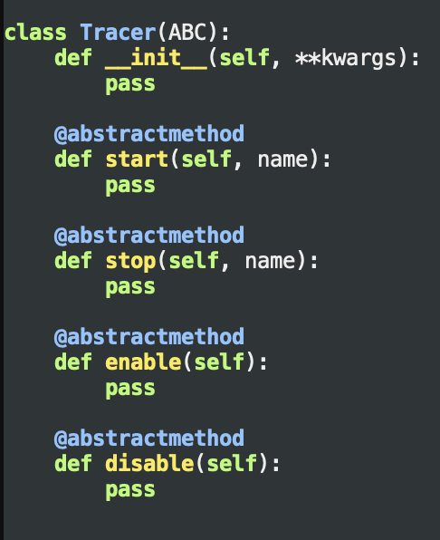
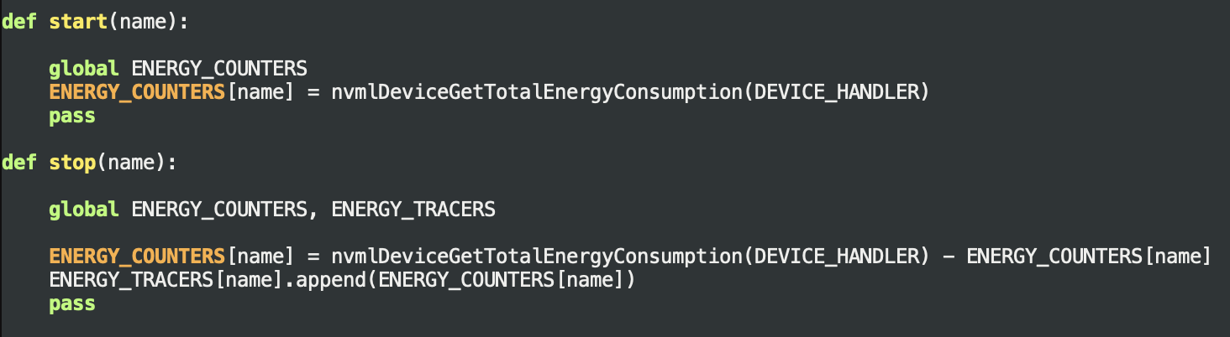
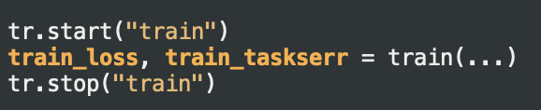
Enabling Level-2 Fingerprinting (Contd)
Parent Class
For systems with nvidia GPUS
nvmlDeviceGetTotalEnergyConsumption() returns an accumulator representing the total energy consumption of the GPU device since the device was first loaded
start(name):
Used to get energy accumulator value before the start of a function
stop(name):
Used to get energy accumulator value after the end of the function, get the difference to get total energy for the specified consumption and append the value to a list
Similarly for AMD gpus amd-smi has the function amdsmi_get_energy_count() which achieves the same purpose
Notes:
The specific functions I use are nvmlDeviceGetTotalEnergyConsumption() & amdsmi_get_energy_count() which returns an accumulator that is a monotonically increasing long long int number which represents the total energy consumption of the GPU (Since it was first loaded)

Slide 9
Case Study: HydraGNN
Distributed Graph Neural Network Training on DOE Supercomputers (Frontier and Perlmutter)

Slide 10
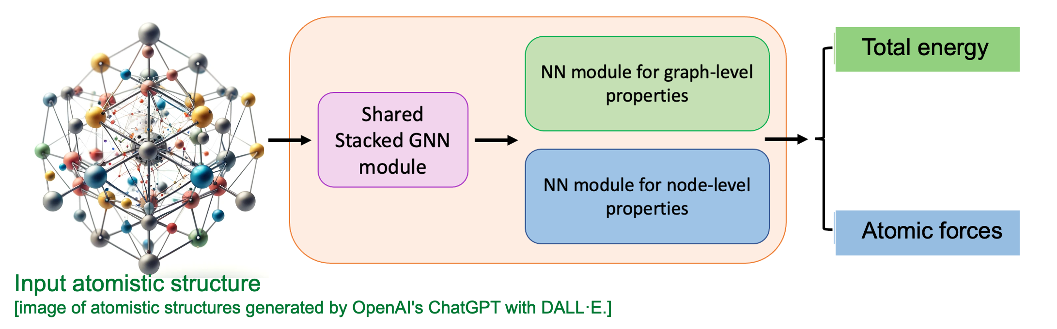
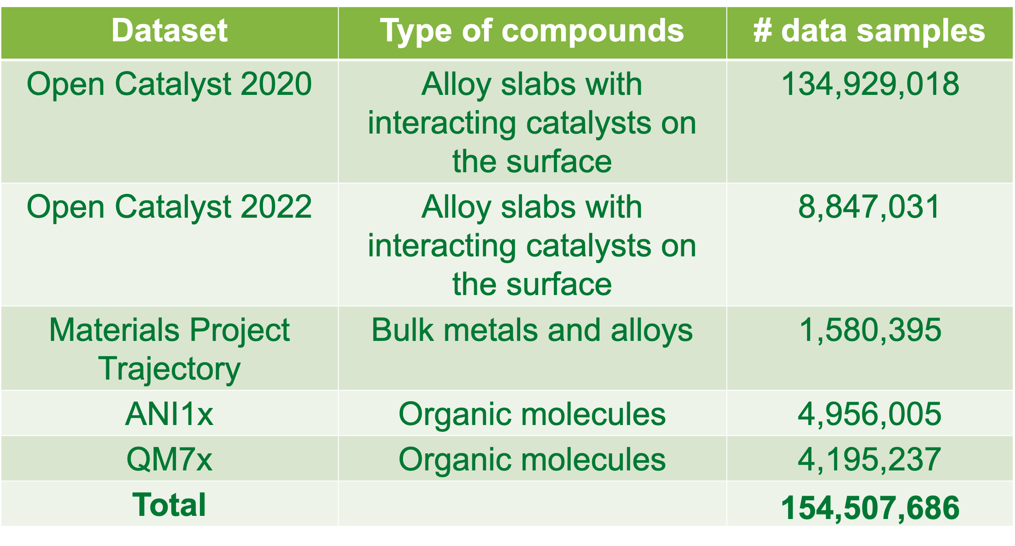
Scalable, supervised graph FM for atomistic materials modeling using HydraGNN
https://www.osti.gov/doecode/biblio/65891
Important to assess chemical stability of an atomistic structure
Important to assess dynamical stability of an atomistic structure

Slide 11
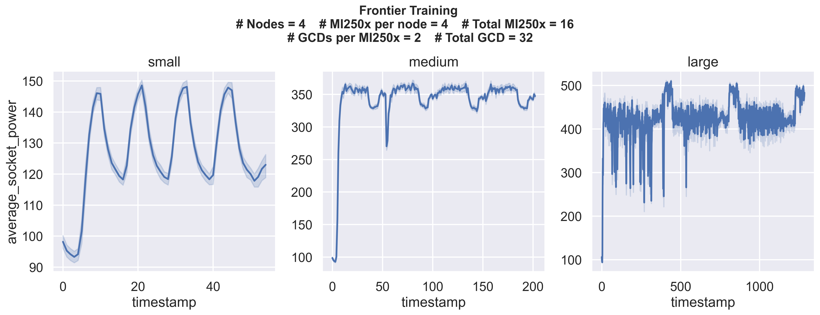
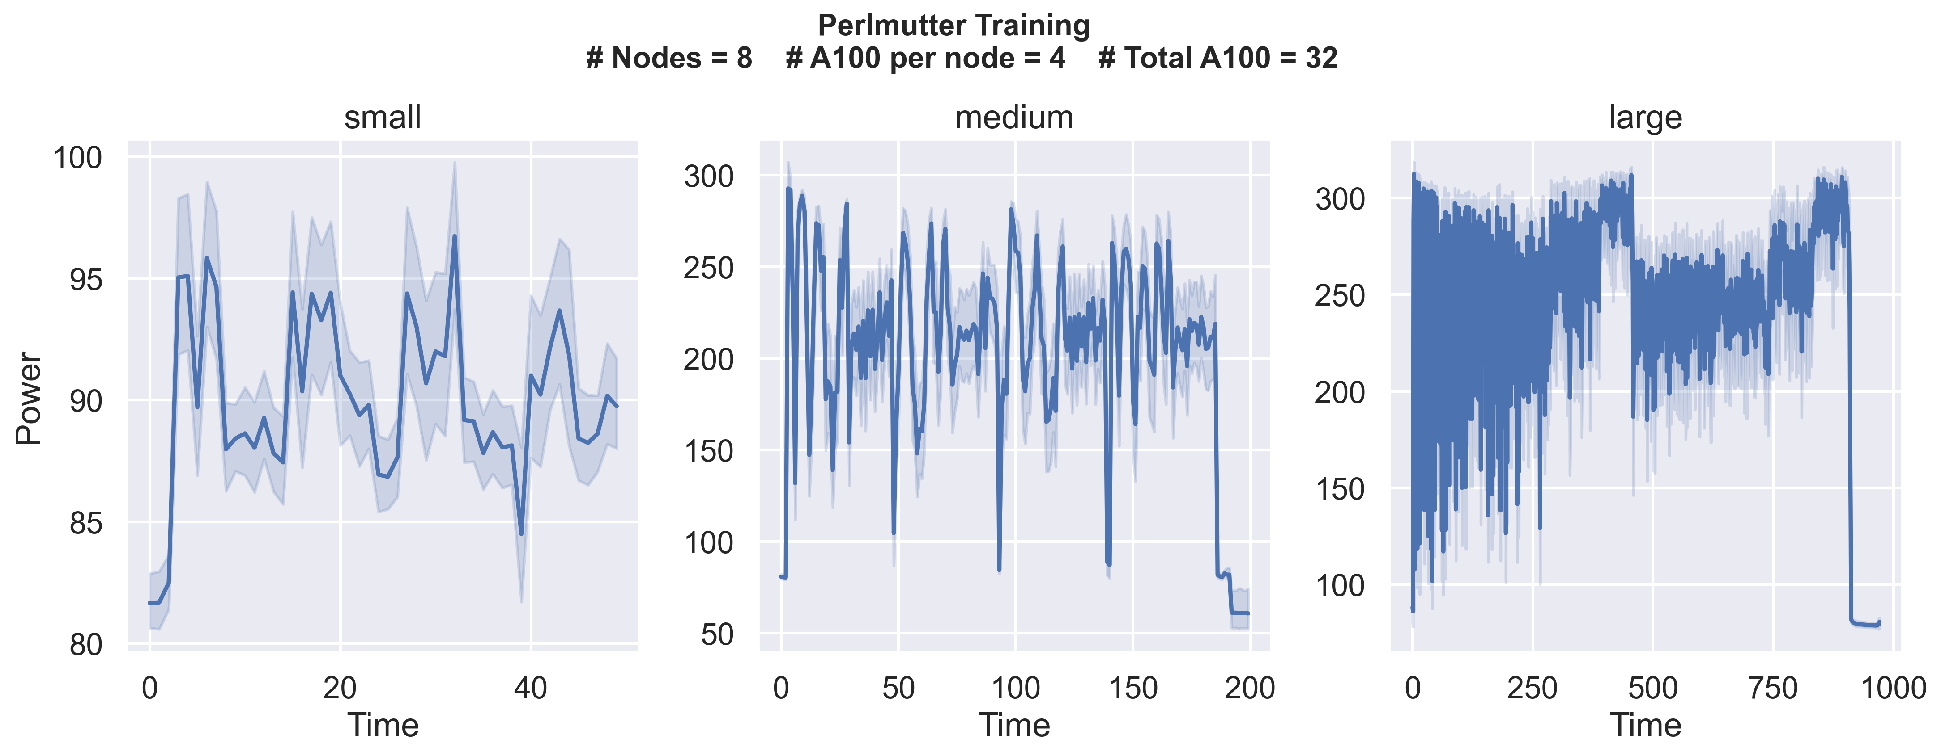
HydraGNN: Level 1 Fingerprinting Results
For 4 epochs of HydraGNN training with increasing model sizes:
Small:58k parameters
Medium: 14M parameters
Large: 156M parameters
Idle GPU power usage :
Frontier : 90W
Perlmutter: 62W
Note:
#GCD per node on Frontier is 2x than that of Perlmutter

Slide 12
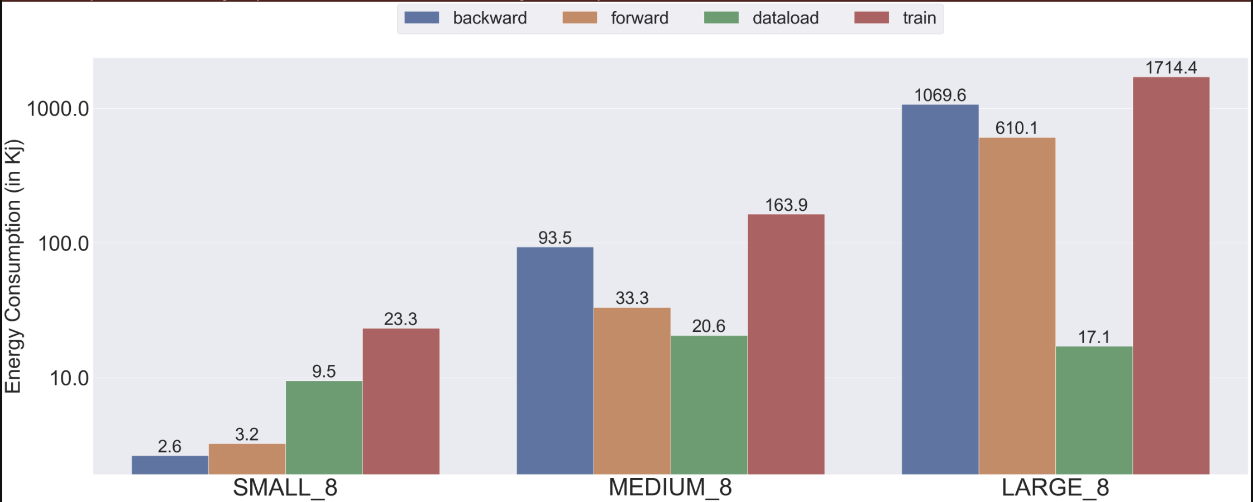
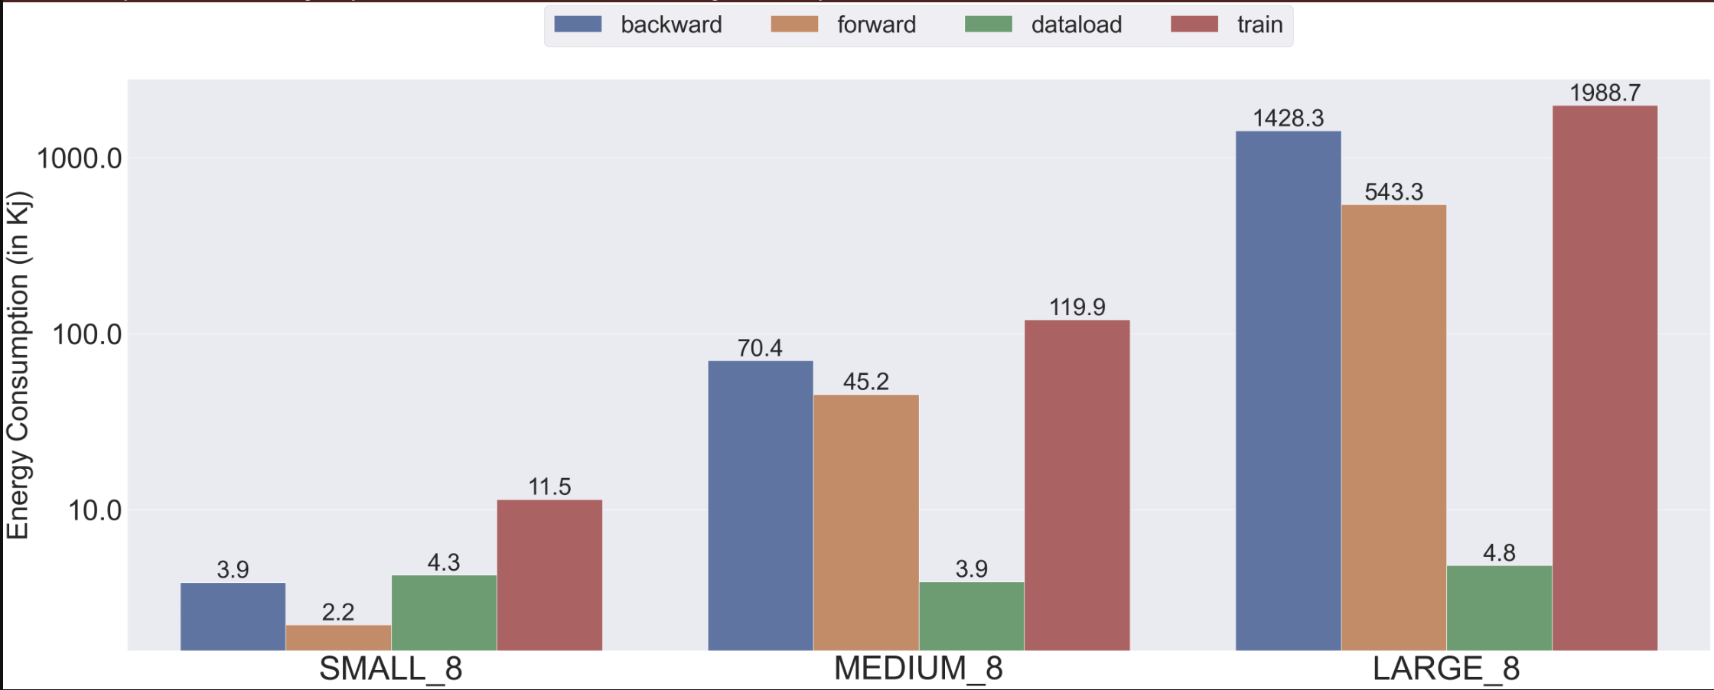
HydraGNN: Level 2 Fingerprinting Results
Profiling of 3 most energy intensive functions:
Train(): One training looping consists of :
Dataload(): Minibatch data is pulled from memory
forward(): Forward computations from input layer to output layer
Backward(): Weight change using gradient descent
Perlmutter
Frontier

Slide 13
Reproducibility Challenges and Lessons Learnt
Hardware Variations:
Variations in how the different hardware are configured make it difficult to account for consistency in reporting.
Each AMD MI250x GPUs have two Graphic Compute Die’s (GCD) attached to one socket.
SLURM reads each GCD as a separate GPU. However, the ROCM library only reports energy consumption per socket, therefore the energy reported by the ROCM is for two GCDs.
On the other hand, For Nvidia A100 GPUs there is only one GCD per GPU and therefore the per socket energy consumption reported by NVML is for only one GCD.
Measurement Overhead:
The overhead of monitoring tools can differ between architectures, complicating the interpretation of energy results when reproducing experiments.
One epoch of training results in about ~2000 calls to read the GPU’s energy counter.
However, for time-cost for making such calls on Nvidia GPUs using NVML was found to be almost 10x more compared to the same calls on an AMD GPU using ROCM libraries.
Software Dependency from multiple vendors:
Having to work with different libraries from different vendors raises the challenge of making sure all the software libraries work as specified without any errors.

Slide 14
Conclusion
Enhanced Workflow Transparency:
Clear record of energy usage across functions, capturing nuances that general metrics might miss.
Improved Reproducibility:
Fine-grained energy data acts as an additional reproducibility metric
Helps verify that jobs consistently perform within expected energy ranges across runs and systems.
Targeted Optimization and Consistency:
Identifies specific areas of high energy use
Enables researchers to optimize these areas while maintaining consistency
Supports Cross-Platform Comparability:
Function-level energy profiles help normalize for differences across hardware setups
Improves reproducibility workflows on different HPC platforms.
Drives Sustainable Practices:
Fine-grained profiling encourages sustainable HPC practices
Aligns reproducibility with energy efficiency goals.

Slide 15
Acknowledgments
This research is sponsored by the Artificial Intelligence Initiative as part of the Laboratory Directed Research and Development (LDRD) Program of Oak Ridge National Laboratory, managed by UT-Battelle, LLC, for the US Department of Energy under contract DE-AC05-00OR22725.
This research used resources of the Oak Ridge Leadership Computing Facility and of the Edge Computing program at the Oak Ridge National Laboratory. Computer time was provided by the INCITE program using the OLCF award CPH161 (AY2024).
This research also used resources of the National Energy Research Scientific Computing Center (NERSC), which is supported by the Office of Science of the U.S. Department of Energy under Contract No. DE-AC05-00OR22725 and No. DE-AC02-05CH11231using NERSC awards ASCR-ERCAP0027259 (AY2024) and BES-ERCAP0030519.
This research was also supported in part by an appointment to the Oak Ridge National Laboratory GRO Program, sponsored by the U.S. Department of Energy and administered by the Oak Ridge Institute for Science and Education.

Slide 16
Thank you! Questions?

